Slide 1
Intro to Cloud Computing CS4037 (BCS-6A) Lecture 12
Danyal Farhat
FAST School of Computing
NUCES Lahore

Slide 2
Module 6: Compute
AWS Academy Cloud Foundations

Slide 3
Section 5: Introduction to AWS Lambda
Module 6: Compute

Slide 4
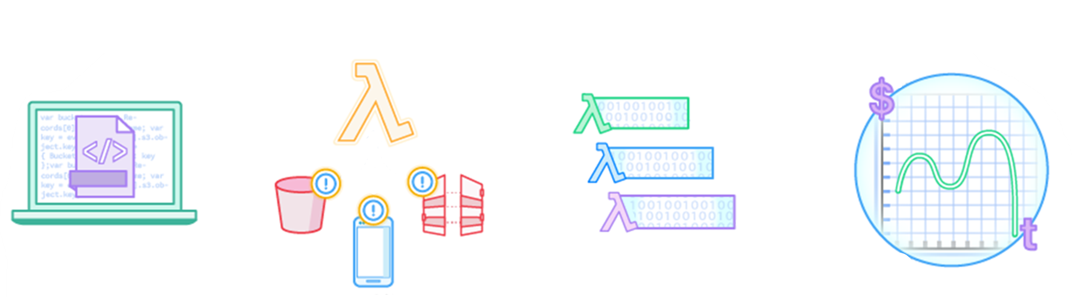

AWS Lambda: Run code without servers
AWS Lambda is a serverless compute service.
The code you run
is a Lambda function
Upload your code
AWS services
HTTP endpoints
Your code runs only when it is
triggered
Pay only for the compute time that you use
Mobile apps
Run your code on a schedule
or in response to events

Slide 5






Benefits of Lambda
It supports multiple programming languages
Completely automated administration
Built-in fault tolerance
It supports the orchestration of multiple functions
Pay-per-use pricing
AWS
Lambda

Slide 6








AWS Lambda event sources
Event sources
Configure other AWS services as event sources to invoke your function as shown here.
Alternatively, invoke a Lambda function from the Lambda console, AWS SDK, or AWS CLI.
Amazon S3
Amazon DynamoDB
Amazon Simple Notification Service (Amazon SNS)
Lambda function
Running of your code (only when triggered)
Amazon Simple Queue Service (Amazon SQS)
AWS Lambda
Amazon API Gateway
Logging, monitoring, and metrics
Application Load Balancer
Amazon
CloudWatch
Many more…

Slide 7




AWS Lambda function configuration
Lambda function configuration
Function code
Running of your code (only when it is triggered)
AWS Lambda function
Dependencies
(code libraries, etc.)
AWS Lambda
Logging, monitoring, and metrics
Amazon
CloudWatch
Execution role

Slide 8

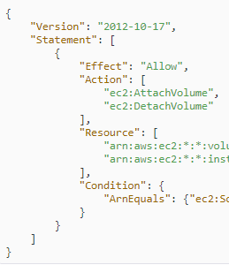

Schedule-based Lambda function example: Start and stop EC2 instances
Stop instances example
Stop
IAM role
Start instances example
Time-based CloudWatch event
1
2
Lambda function triggered
3
EC2 instances stopped
Start
IAM role
Time-based CloudWatch event
EC2 instances started
4
5
Lambda function triggered
6

Slide 9







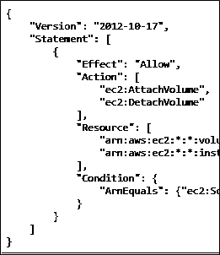
Event-based Lambda function example: Create thumbnail images
AWS Cloud
1
2
3
User
Source bucket
Lambda
4
Execution role
5
Access policy
Target bucket
Lambda function

Slide 10
AWS Lambda quotas
Soft limits per Region:
Concurrent executions = 1,000
Function and layer storage = 75 GB
Hard limits for individual functions:
Maximum function memory allocation = 10,240 MB
Function timeout = 15 minutes
Deployment package size = 250 MB unzipped, including layers
Container image code package size = 10 GB
Additional limits also exist. Details are in the AWS Lambda quotas documentation at https://docs.aws.amazon.com/lambda/latest/dg/gettingstarted-limits.html.

Slide 11

Section 5 key takeaways
Serverless computing enables you to build and run applications and services without provisioning or managing servers.
AWS Lambda is a serverless compute service that provides built-in fault tolerance and automatic scaling.
An event source is an AWS service or developer-created application that triggers a Lambda function to run.
The maximum memory allocation for a single Lambda function is 10,240 MB.
The maximum run time for a Lambda function is 15 minutes.

Slide 12
Activity: Create an AWS Lambda Stopinator Function
To complete this activity:
Go to the hands-on lab environment and launch the AWS Lambda activity.
Follow the instructions that are provided in the hands-on lab environment.

Slide 13
Activity debrief: key takeaways

Slide 14
Section 6: Introduction to AWS Elastic Beanstalk
Module 6: Compute

Slide 15

AWS Elastic Beanstalk
An easy way to get web applications up and running
A managed service that automatically handles –
Infrastructure provisioning and configuration
Deployment
Load balancing
Automatic scaling
Health monitoring
Analysis and debugging
Logging
No additional charge for Elastic Beanstalk
Pay only for the underlying resources that are used
AWS Elastic
Beanstalk

Slide 16

AWS Elastic Beanstalk deployments
It supports web applications written for common platforms
Java, .NET, PHP, Node.js, Python, Ruby, Go, and Docker
You upload your code
Elastic Beanstalk automatically handles the deployment
Deploys on servers such as Apache, NGINX, Passenger, Puma, and Microsoft Internet Information Services (IIS)
You
manage
Your code
HTTP server
Application server
AWS
manages
Language interpreter
Operating system
Host

Slide 17




Benefits of Elastic Beanstalk
Fast and simple to start using
Developer productivity
Difficult to outgrow
Complete resource control

Slide 18
Activity: AWS Elastic Beanstalk
To complete this activity:
Go to the hands-on lab environment and launch the AWS Elastic Beanstalk activity.
Follow the instructions that are provided in the hands-on lab environment.

Slide 19
Activity debrief: Key takeaways

Slide 20
Section 6 key takeaways
AWS Elastic Beanstalk enhances developer productivity.
Simplifies the process of deploying your application.
Reduces management complexity.
Elastic Beanstalk supports Java, .NET, PHP, Node.js, Python, Ruby, Go, and Docker
There is no charge for Elastic Beanstalk. Pay only for the AWS resources that you use.

Slide 21
Module wrap-up
Module 6: Compute

Slide 22
Module summary
In summary, in this module, you learned how to:
Provide an overview of different AWS compute services in the cloud
Demonstrate why to use Amazon Elastic Compute Cloud (Amazon EC2)
Identify the functionality in the Amazon EC2 console
Perform basic functions in Amazon EC2 to build a virtual computing environment
Identify Amazon EC2 cost optimization elements
Demonstrate when to use AWS Lambda
Demonstrate when to use AWS Elastic Beanstalk
Identify how to run containerized applications in a cluster of managed servers

Slide 23
Additional resources
Amazon EC2 Documentation: https://docs.aws.amazon.com/ec2/
Amazon EC2 Pricing: https://aws.amazon.com/ec2/pricing/
Amazon ECS Workshop: https://ecsworkshop.com/
Running Containers on AWS: https://containersonaws.com/
Amazon EKS Workshop: https://www.eksworkshop.com/
AWS Lambda Documentation: https://docs.aws.amazon.com/lambda/
AWS Elastic Beanstalk Documentation: https://docs.aws.amazon.com/elastic-beanstalk/
Cost Optimization Playbook: https://d1.awsstatic.com/pricing/AWS_CO_Playbook_Final.pdf

Slide 24
Thank you
All trademarks are the property of their owners.

